Slide 1
Solar Flares

Slide 2
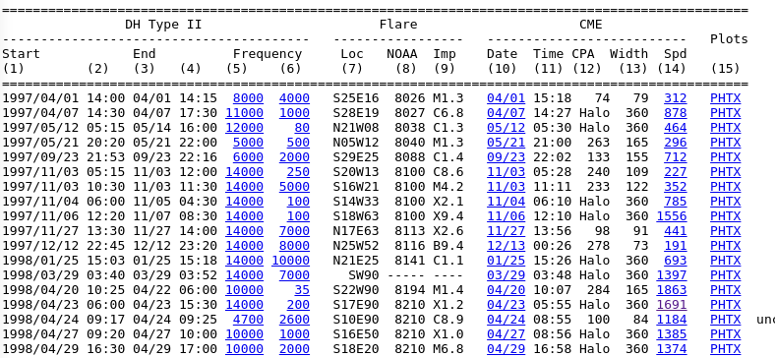
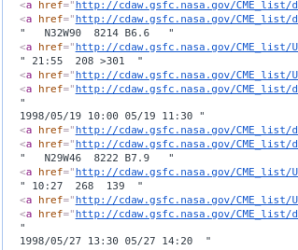
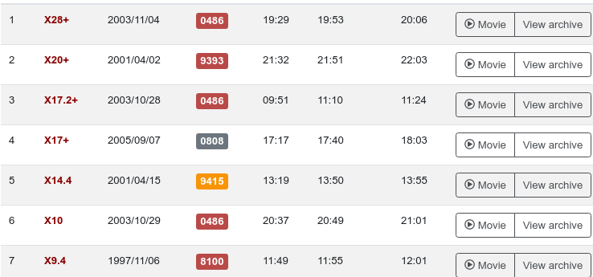
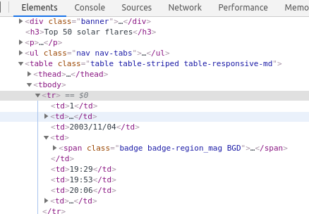
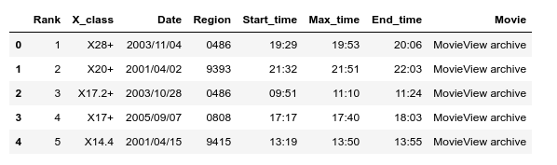
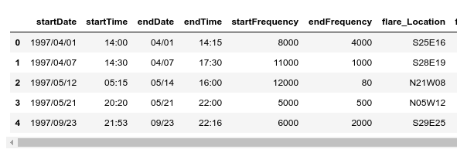
Scrapping
spaceweatherlive.com
NASA
Normal HTML File e.g. containing table tag
BeautiflSoup was enough
Messy HTML File e.g. not containing tags
BeautiflSoup wasn’t enough: Regex

Slide 3
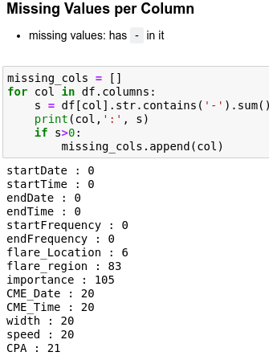
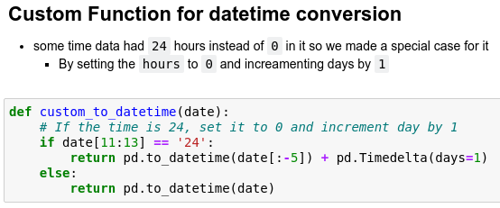
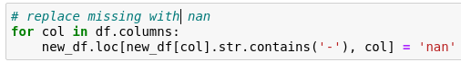
Tidying
Dropping unnecessary columns
And Handling missing values
Converting time columns to pandas timestamp

Slide 4
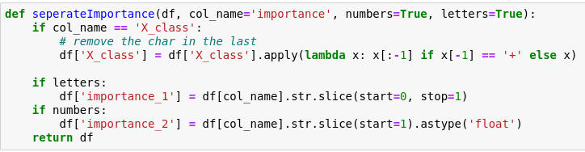
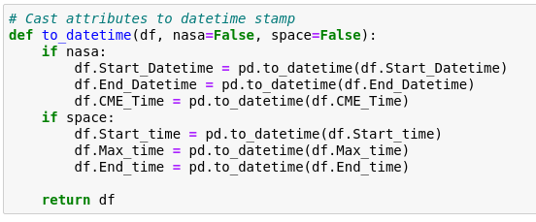
Getting Data Ready For Analysis and Helper Functions
Separate importance
- importance_1: character representing the Solar Flare class
- importance_2: float representing the class value
Custom datetime conversion function
- some time data had 24 hours instead of 0 in it so we made a special case for it
- By setting the hours to 0 and incrementing days by 1

Slide 5
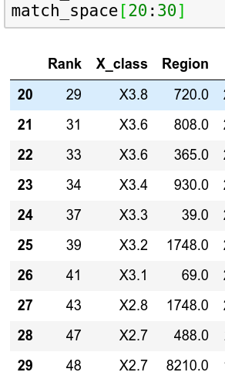
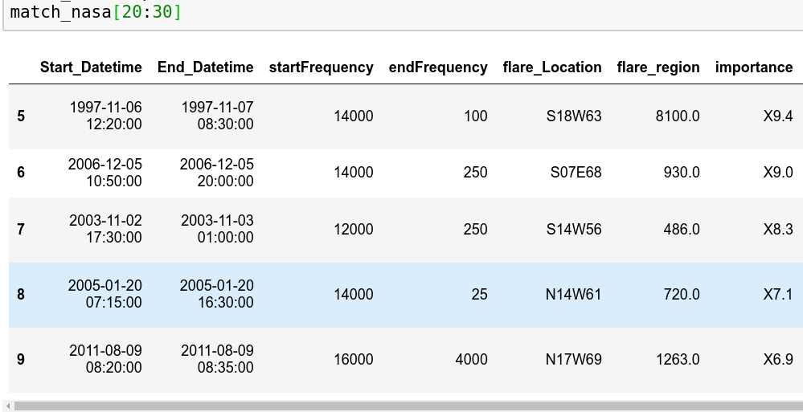
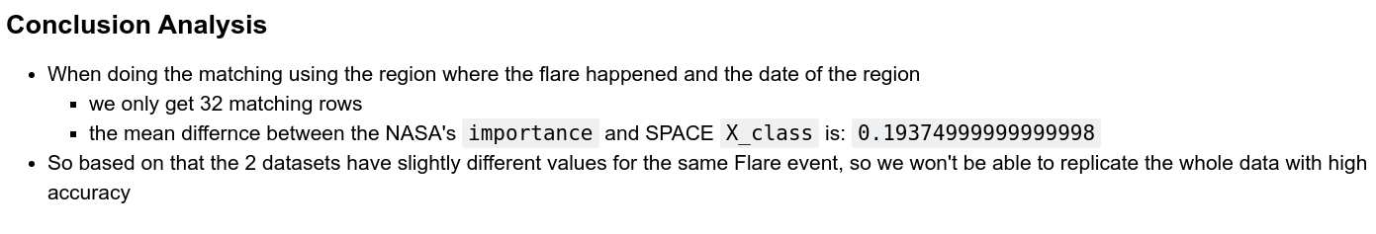
Replication Criteria - not working
Criteria
1. same region
2. same starting time

Slide 6
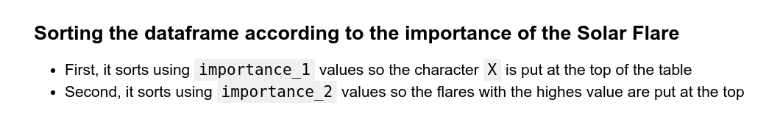
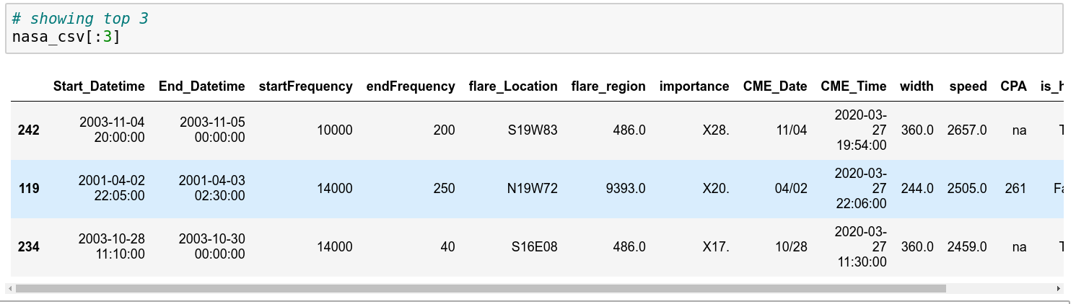
Replication - Using the importance

Slide 7
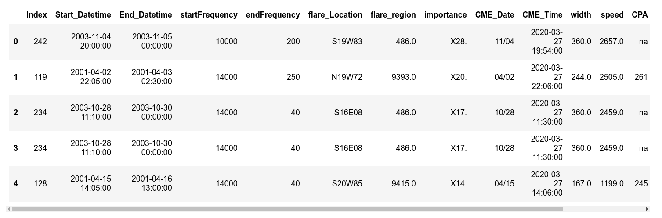
Integration
Criteria
- After reading about Solar Flares we found that the most defining feature is the importance/X_class of the flare, so we built our criteria around it.
Steps
1- get the difference between the current solar flare X_class in the SPACE dataframe and get the difference between it and all importance values in the NASA dataframe
2 - get the NASA row with the smallest difference as the matching row
3- add the Space_Rank column to the NASA dataframe

Slide 8
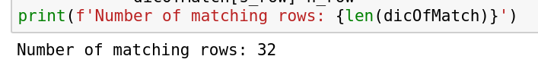
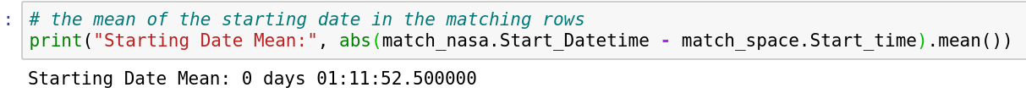
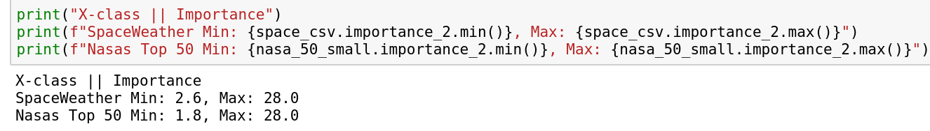
Why didn't we use the region or the starting date?
- we didn't use the region as it won't produce 50 rows, as some regions are available at SPACE dataframe but not in NASA
- we also didn't use the starting date as it's not consistent in the 2 dataframes
Why did we use NASA TOP 50 instead of NASA
- we found that NASA TOP 50's range was enough to cover the whole range of X_class values of SPACE dataframe so there will be no need to compare the whole NASA dataframe

Slide 9
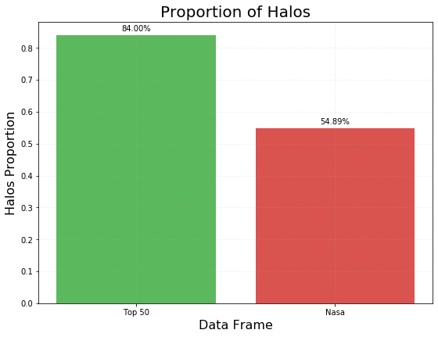
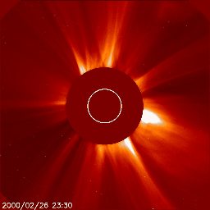
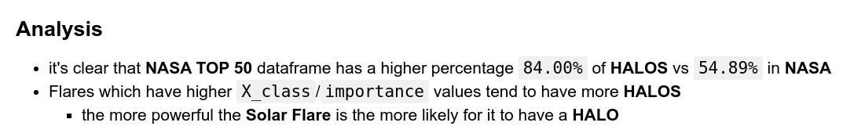
Analysis: Halo Proportion

Slide 10
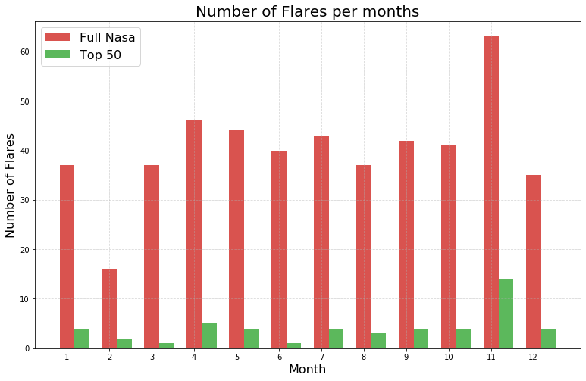
Do Strong Flares Cluster in time?
First
- The solares flares events are spread and occur during all months of the year
Second
- All types of Solar Flares are minimum during February
- Strong Solar flares are minimum during March and June
Third
- The highest number of Solar Flares events occurs in November
- And November has also the highest number of Strong Solar Flares

Slide 11
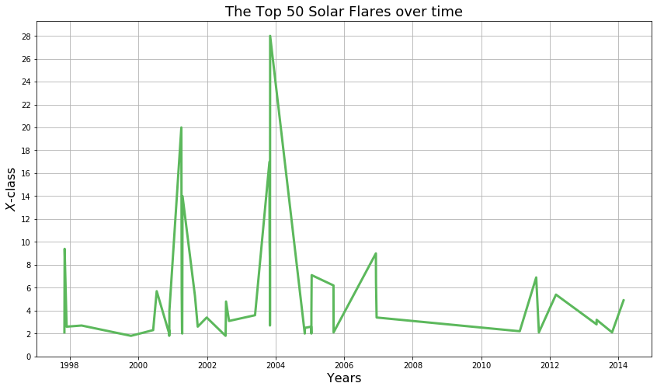
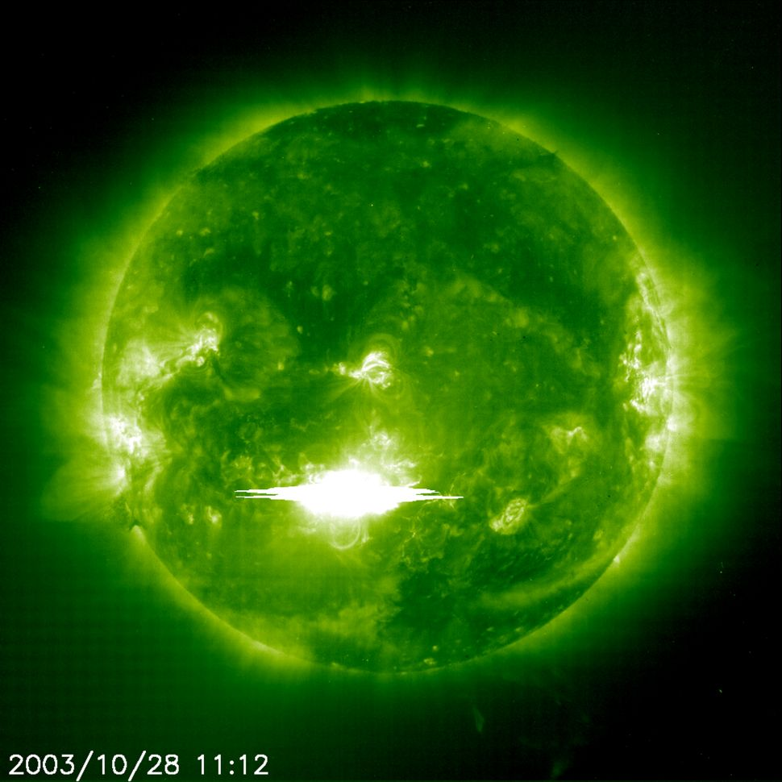
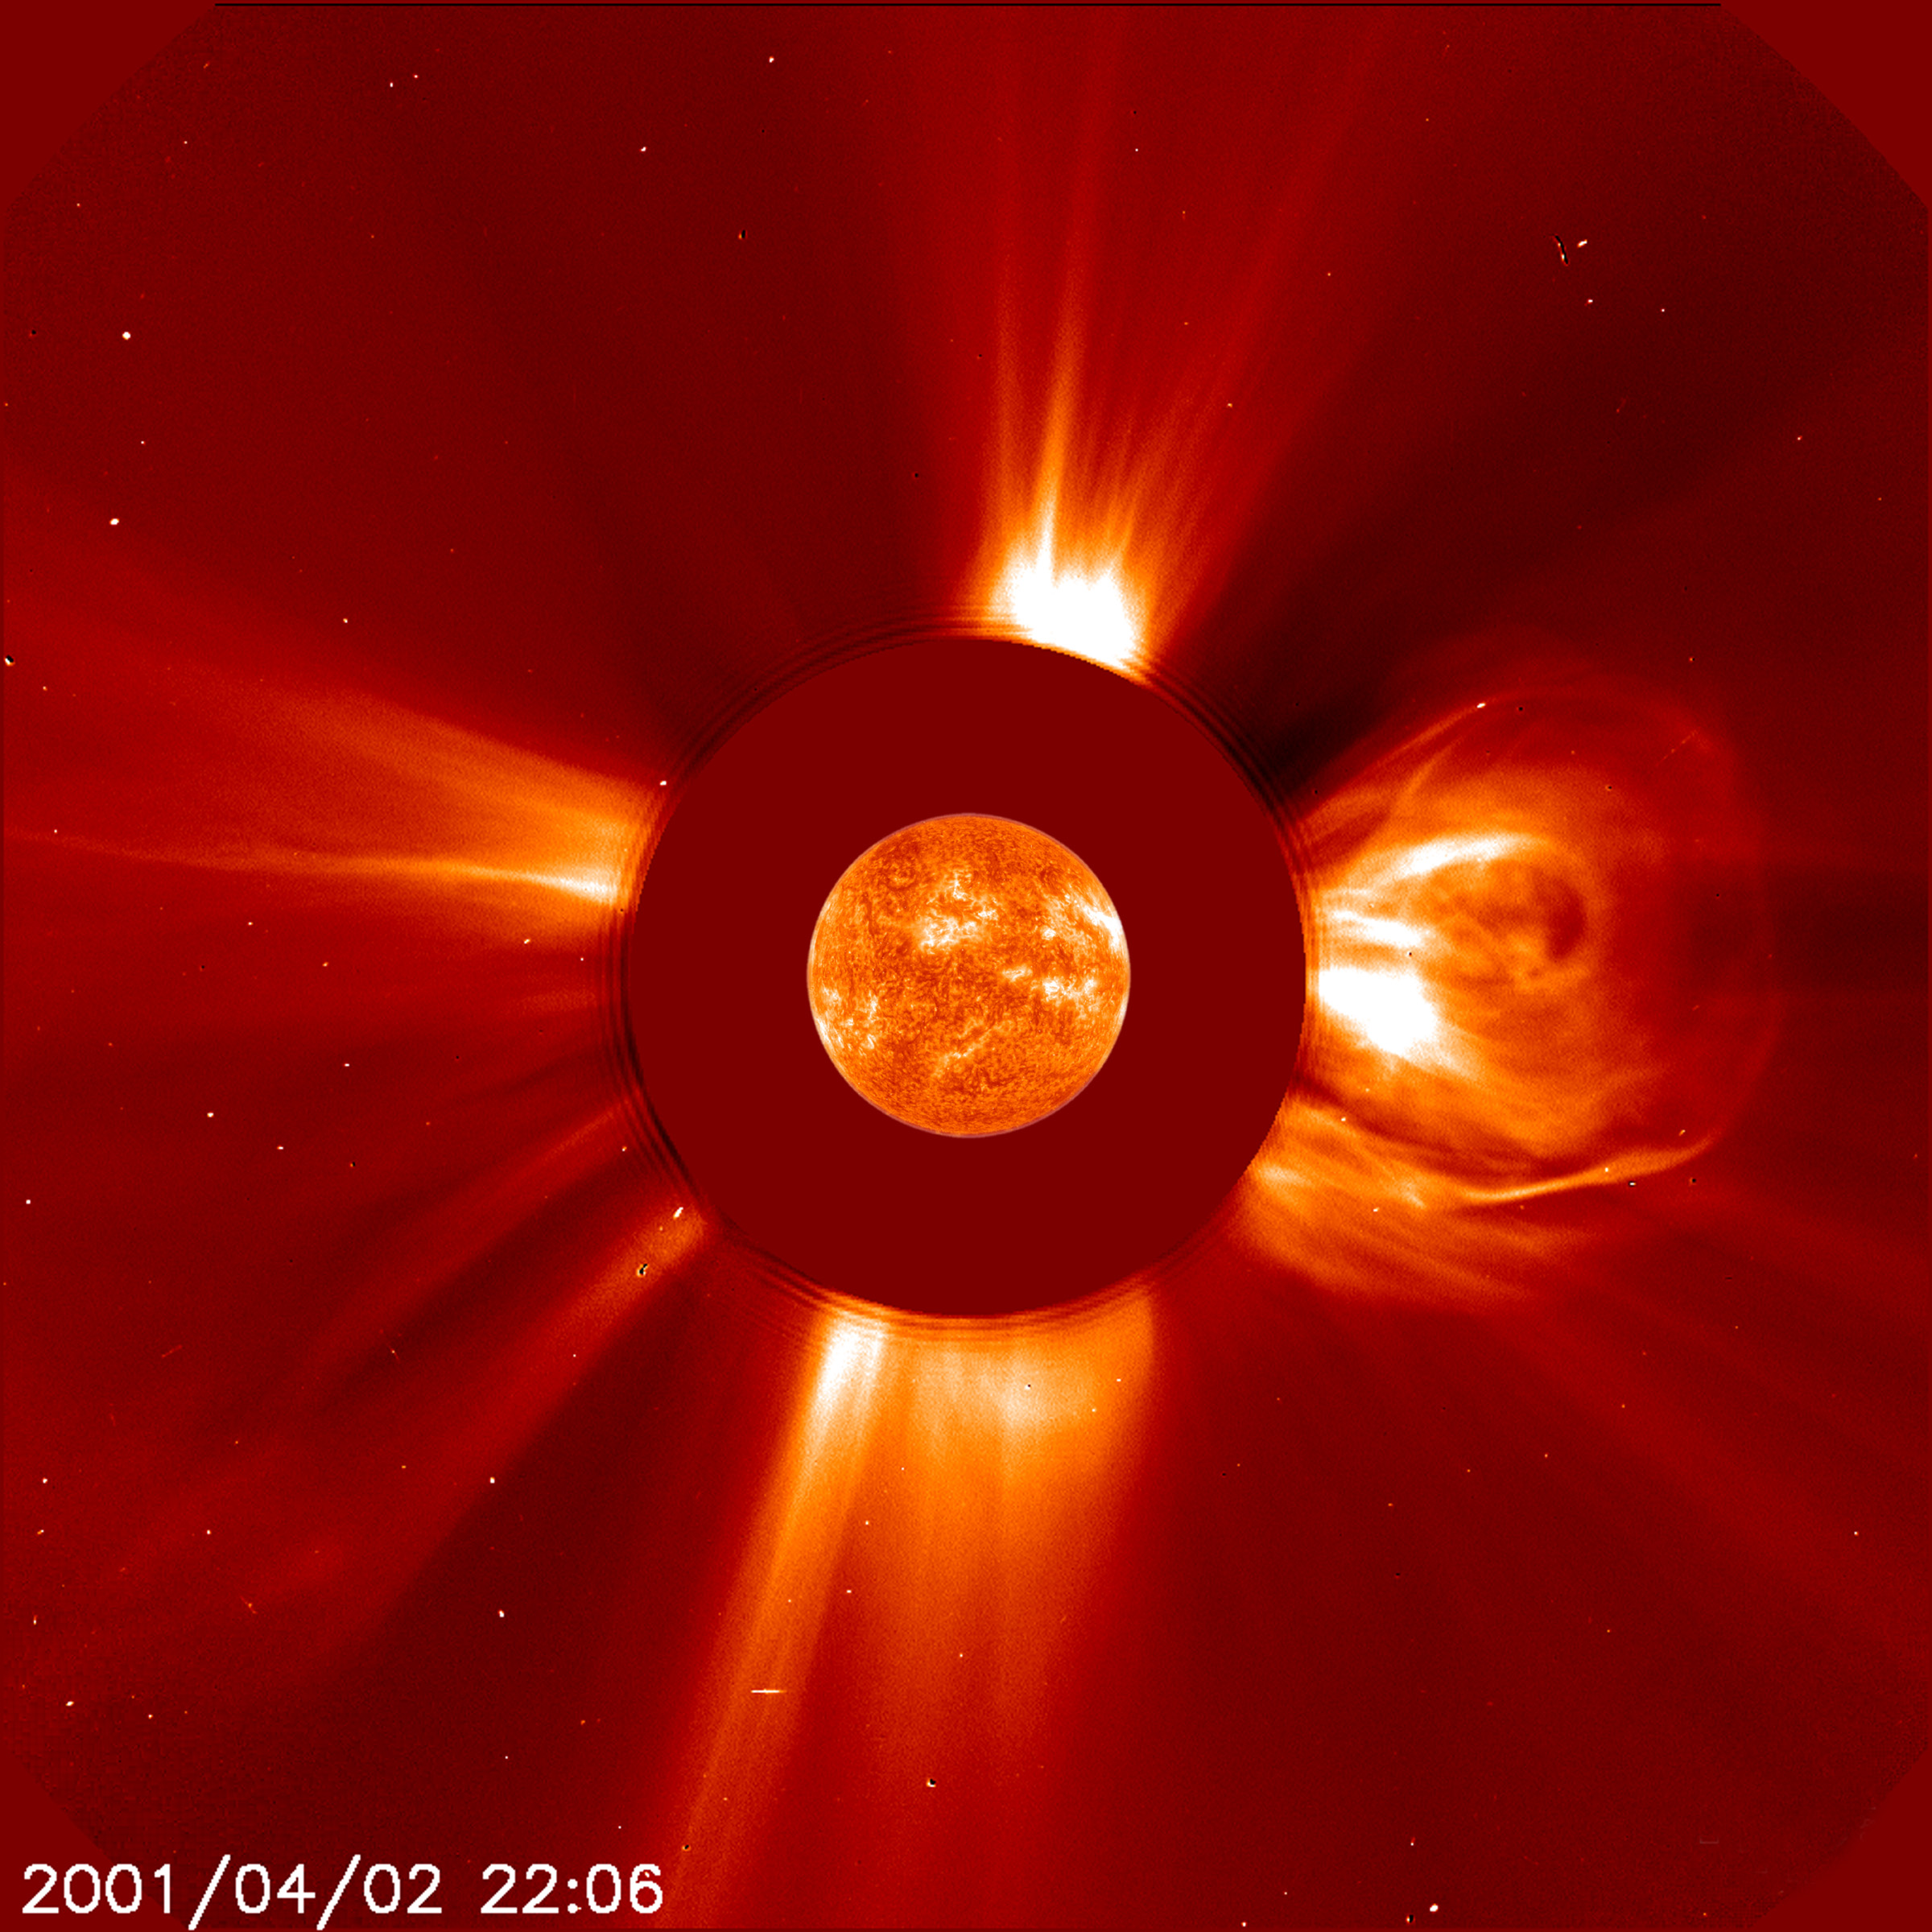
Top 50 Solar Flares Over Time
First
- The last 10 years [2005 to 2015], all solar flares were relatively small as no solar flare approached X10
- and X_class Solar Flares occurred every year without stopping from 1998 to 2015
Second
- The most powerful events occurred between 2001 and 2005
> At 4:51 p.m. EDT, on Monday, April 2, 2001, the sun unleashed the biggest solar flare ever recorded, as observed by the Solar and Heliospheric Observatory (SOHO) satellite.
> scientists worldwide got the spooks when a Halloween solar storm disrupted communications, GPS and even a United States defense operation.
Biggest Ever recorded at its time(2001)
[Giant Halloween] (late 2003)

Slide 12
Conclusion

Slide 13
Videos
Part 1
Part 2

